Slide 1

Welcome
EIC EDGE – Week 2 Software Development Practice
Notes:
Mandatory
ACTION: Adjust title to fit your course.

Slide 2
Why study these subjects?
Being able to effectively apply your software development methodology in practice can be the difference between success and failure
Making judicious use of automated unit tests helps you practice “shift left” and high quality
Knowing how to troubleshoot issues with code as you develop helps you complete tasks and find and fix bugs
Understanding key deployment technologies like Docker and Kubernetes helps you deliver software faster
Understanding principles of good code review helps you contribute to overall team success

Slide 3
My pledge to you
I will...
Make this interactive
Ask you questions
Ensure everyone can speak
Use an on-screen timer
Notes:
Mandatory
Script: This is my pledge to you. I’d like to talk in particular about the third bullet. Sometimes in a class, an enthusiastic participant will want to speak out in every discussion, answer every question and so forth. I want to make sure all of you have the opportunity to be heard. So, if I haven’t heard from you in awhile, I may call on you or check in via chat, because I want to make sure everyone gets their questions answered. Also, I want to demonstrate the timer and confirm that everyone can see it. EggTimer is a good timer - https://e.ggtimer.com/

Slide 4
Objectives
At the end of this course, you will be able to:
Write automated unit tests in Python, measure code coverage as part of a TDD-strategy, and troubleshoot issues encountered when building Python apps
Use Docker to containerize workloads, enabling consistent delivery of high-quality software regardless of deployment target
Contribute to team productivity by effectively reviewing and providing feedback on code changes
Notes:
Mandatory
ACTION: Adjust objectives to fit your course.
Use measurable objectives that start with action verbs such as: describe, define, identify, assess, demonstrate, use, utilize. https://elearningindustry.com/writing-learning-objectives-for-elearning-what-elearning-professionals-should-know

Slide 5
Agenda
Day One
Python Refresh, Part 1
Day Two
Python Refresh, Part 2
Unit Testing/Debugging in Python, Part 1
Day Three
Unit Testing/Debugging in Python, Part 2
Code Review Best Practices

Slide 6
Agenda
Day Four
Docker & Kubernetes, Part 1
Day Five
Docker & Kubernetes, Part 2
Notes:
Day 3 - Intro to DevSecOps, Introduction to TDD (Automated Testing Concepts, Tools, and FWs)
Shifting left
Static + Dynamic scans
Container scans?
Code quality - code coverage, cyclomatic complexity, unit tests passing, etc.
The 3 Laws
Code coverage
Technical debt
Motivation for automated testing
Days 4,5 - GitHub (Version Control, Branching, Tagging)
Version control
Branching
Tagging
Pull requests

Slide 7
How we’re going to work together
Lab work will take place in individual workspaces – isolated, browser-based virtual machines
Classroom labs may include individual work as well as group discussion and work
I welcome being interrupted – if you need more info, or clarification, or anything else, just break in and ask. I am here to help you.
Notes:
Mandatory
ACTION: Adjust bullets as per your course.
In this section, discuss the structure of the course—exercises, labs, etc.
Also, discuss any resources students will be using.

Slide 8
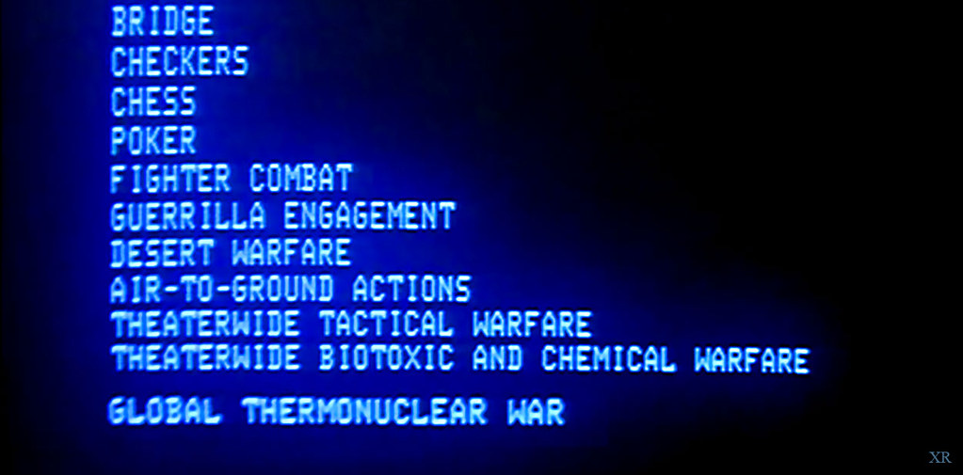
Would you like to play a game?
To make it interesting, let’s add a competition factor to our time together ☺
For questions posed to the larger group, 1 point will be awarded for each answer provided by a participant
2 points will be awarded for acting as a spokesperson for a breakout room during one of our group discussions
There will be a rubric provided for the capstone (targeted for week 4) which will define a points breakdown for the implemented solution

Slide 9
Python Refresh

Slide 10
Data Types, Operators, and Variables
https://github.com/KernelGamut32/intermediate-python/blob/main/01%20Data%20Types%2C%20Operators%2C%20and%20Variables.ipynb

Slide 11
Conditionals
https://github.com/KernelGamut32/intermediate-python/blob/main/02%20Conditionals.ipynb

Slide 12
Functions
https://github.com/KernelGamut32/intermediate-python/blob/main/03%20Functions.ipynb

Slide 13
Looping
https://github.com/KernelGamut32/intermediate-python/blob/main/04%20Looping.ipynb

Slide 14
Additional Datatypes
https://github.com/KernelGamut32/intermediate-python/blob/main/05%20Additional%20Datatypes.ipynb

Slide 15
Files and Regular Expressions
https://github.com/KernelGamut32/intermediate-python/blob/main/06%20Files%20and%20Regular%20Expressions.ipynb

Slide 16
Modules
https://github.com/KernelGamut32/intermediate-python/blob/main/07%20Modules.ipynb

Slide 17
Object-Oriented Programming
https://github.com/KernelGamut32/intermediate-python/blob/main/08%20Object-Oriented%20Programming.ipynb

Slide 18
Unit Testing/Debugging in Python

Slide 19






Common Components of a Unit Testing Framework
Base class defined in the framework from which test classes derive
Fixtures that run before and after blocks of test code
Assertions – the automated evaluation executed against our code to verify
Test suite that collects a group of related tests to be executed together
Runner built-in to the framework that executes the tests
Reporting mechanism that can provide results in different formats
Notes:
Several frameworks supported – unittest, pytest, nose/nose2

Slide 20
Arrange, Act, Assert (AAA)
Pattern used in unit testing to help us organize our tests, improve readability, and ensure good practice when building tests.

Slide 21

Arrange
Execute any required set up in preparation for running one or more tests
Can include creation of objects that will be needed during test execution
Might also include set up of mocks (to ensure test isolation) or creation of test data (if directly testing data access methods)

Slide 22

Act
Exercising the code under test
Executing any methods or actions on the class structures you want to verify
Representative of how code might be called in production
Should not include an extensive amount of code – otherwise, could be a “smell” that you’re testing too much in a given test case

Slide 23

Assert
Does the result match my expectation for how the code under test should function?
Determines pass/fail for the test
Often tests will have only a single assert
Can include multiple asserts, but the asserts should all relate cohesively to the same function/test case/object

Slide 24
Writing Unit Tests in unittest
Notes:
INSTRUCTOR NOTES:
REVIEWER COMMENTS:

Slide 25
unittest Framework
Included in Python standard library
Provides a framework for building and running unit tests against Python code (functions, classes, etc.)
A Python file houses code that will be used to automate the testing

Slide 26
unittest Framework
Test code imports unittest and module under test
We write Python methods to exercise our business logic and verify expected outputs

Slide 27

unittest Framework - Keys
Our test class derives from unittest.TestCase
Several versions of “assert” method provide robust validation
Usually, test code and code under test kept in separate files (and potentially in separate folders)
Test fixtures promote reuse and help keep our code clean
unittest offers multiple options for specifying which of a set of tests you want to execute

Slide 28
unittest Framework
unittest includes multiple “assert” methods for checking different kinds of results (expected vs. actual)
Can exercise tests through unittest framework
Results will indicate success (or failure)

Slide 29
unittest Framework
Assert methods include (among others):
assertEqual/assertNotEqual
assertTrue/assertFalse
assertIn/assertNotIn

Slide 30
LAB:
Review the documentation on the different types of assert methods available with unittest (at https://docs.python.org/3/library/unittest.html#assert-methods).
Create a test module and include tests to successfully exercise each type of assert using simple expressions. Investigate/drilldown into documentation on each type of assert as needed to understand its usage.
unittest Assert Methods

Slide 31
unittest Framework – Test Fixtures
Rather than repeat common logic across tests, unittest provides a couple of options for capturing:
setUp
tearDown
Includes a few different forms

Slide 32
unittest Framework – Test Fixtures
setUpModule
setUpClass
setUp
Class
Test
Module
tearDown
tearDownClass
tearDownModule

Slide 33
unittest Framework – Test Fixtures
setUpModule
Called once before anything else in the module
setUpClass
setUp
Class
Test
Module
tearDown
tearDownClass
tearDownModule

Slide 34
unittest Framework – Test Fixtures
setUpModule
setUpClass
Called once before any test executed in the class
setUp
Class
Test
Module
tearDown
tearDownClass
tearDownModule
Notes:
Requires decoration as a class method (@classmethod) – called on class vs instance of class (like static)

Slide 35
unittest Framework – Test Fixtures
setUpModule
setUpClass
setUp
Called before each test is executed (multiple)
Class
Test
Module
tearDown
tearDownClass
tearDownModule

Slide 36
unittest Framework – Test Fixtures
setUpModule
setUpClass
setUp
Class
Test
Module
Called after each test is executed (multiple)
tearDown
tearDownClass
tearDownModule

Slide 37
unittest Framework – Test Fixtures
setUpModule
setUpClass
setUp
Class
Test
Module
tearDown
Called once after all tests executed (if setUpClass successful)
tearDownClass
tearDownModule
Notes:
Requires decoration as a class method (@classmethod) – called on class vs instance of class (like static)

Slide 38
unittest Framework – Test Fixtures
setUpModule
setUpClass
setUp
Class
Test
Module
tearDown
tearDownClass
Called once after everything else in the module
tearDownModule

Slide 39
LAB:
Review the documentation on the different types of test fixture methods available with unittest (at https://docs.python.org/3/library/unittest.html#organizing-test-code and https://docs.python.org/3/library/unittest.html#setupclass-and-teardownclass).
Create a test module and include tests to practice utilization of setUp(), tearDown(), setUpClass(), and tearDownClass(). You can use simple print statements to experiment with the different test fixture methods and their timings.
unittest Test Fixtures

Slide 40
unittest Framework – Managing Test Execution
Options
As an executable module
Using unittest to execute entire module
Using unittest to execute single test class (or individual test cases)
Create a test package

Slide 41
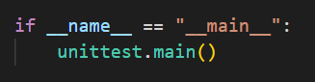
unittest Framework – Managing Test Execution
As an executable module
Add the following to your test module:
Can execute all tests in module using `python -m <test_module_name>` or `python <test_module_name>.py`

Slide 42
unittest Framework – Managing Test Execution
Using unittest to execute entire module
X
Does not require:
Can execute all tests in module using `python -m unittest <test_module_name>` or `python -m unittest <test_module_name>.py`

Slide 43
unittest Framework – Managing Test Execution
Using unittest to execute single test class (or individual test cases)
X
Does not require:
Can execute a specific test class using `python -m unittest <test_module_name>.<test_class_name>`. Can execute a specific test case using `python -m unittest <test_module_name>.<test_class_name>.<test_case_name>`

Slide 44
unittest Framework – Managing Test Execution
Create a test package
X
Does not require:
Capture test modules under a folder and add a `__init__.py` package initializer with simple contents:
From root folder containing package, can execute using variants of `python -m unittest <package_name>.<test_module_name>[.<test_class_name>.<test_case_name>]`
Notes:
__init__.py is what really defines a Python package as a package

Slide 45

unittest Framework – Test Discovery
unittest also supports a “discovery” mode
Quickly execute all tests in the project directory and its subdirectories
Available using `python -m unittest discover` or simply `python -m unittest`
All test files must be modules or packages importable from top-level directory
By default, starts from current directory
By default, searches for test*.py pattern in filenames to identify tests to be executed

Slide 46

unittest Framework – Skipping Tests
While permanently skipping tests can be a “smell”, unittest offers options for temporarily skipping:
@unittest.skip() decorator
@unittest.skipIf() decorator
@unittest.skipUnless() decorator
self.skipTest method – call within test to initiate a skip

Slide 47
LAB:
Create a test package containing multiple test modules with tests for simple expressions/asserts. Experiment with the various ways you can execute different combinations of tests.
Review the documentation on the different types of basic skip options available with unittest (at https://docs.python.org/3/library/unittest.html#skipping-tests-and-expected-failures). Create a test module and include tests to practice utilization of each of the basic types (skip, skipIf, skipUnless, and self.skipTest).
unittest – Managing Test Execution
Notes:
Can include a brief discussion of expectedFailure decorator – but encourage that participants fix the test (or delete) rather than allowing to go on failing for an extended period of time

Slide 48

unittest Framework – Managing Test Failures
Sometimes, our tests fail
Any Exception raised in a test case causes that test case to fail
The assert methods raise exceptions if the expected result does not occur (i.e., assertEqual determines not equal)
For certain edge or exception cases, we may expect an Exception to be raised
In those cases, an Exception is success – tests that our code correctly handles bogus data
assertRaises is provided by the unittest framework for this purpose

Slide 49
Mocking – Testing Components in Isolation

Slide 50
Mocking / Test Doubles
We use mocking/test doubles:
To help isolate our testing to focused areas of code
To manage dependencies and help control testing against them
To force special cases that exercise specific code flows
To bring stability and consistency to our tests
Helps make the “unit” in unit testing possible
Notes:
Often use the term “mocking” but the concept is more nuanced
We want to be able to setup conditions that allow us to test in isolation so we can ensure maximum coverage of our code with our tests

Slide 51
Mocking / Test Doubles
Dummies
Fakes
Stubs
Spies
Mocks
Notes:
Maintainable - readable

Slide 52
Dummies
Simplest form of test double
No real functionality – mostly a placeholder
When dependency exists but is not needed for the test
Create and use an empty or straightforward copy
Returns meaningless value on every call

Slide 53
Stubs
Same response regardless of parameters passed
Used to test different paths through code
Allows you to control the value of the dependency
Can also use to force an exception
Create a copy of the dependency and return same value

Slide 54
Spies
Can return a value like a stub
Also provides info about how called
Verify member call with specific parameter values
Verify member call a specific number of times
Verify whether member called or not
Helpful with testing at third party boundaries
Helpful with managing side effects of dependencies

Slide 55
Mocks
Programmable spies
Can return a set value like a spy
Difference is ability to setup test data in the double
Provides additional flexibility - can code the setup
Still only returns set value but it’s the value coded
Trade-off – requires setup work

Slide 56
Fakes
Most powerful type of test double
Acts like the class/component it’s doubling for
Double that’s more sophisticated (but still controlled)
Useful for managing downstream dependencies
Gating database connections
Gating web service calls
File operations
Can appear to integrate but control results
Notes:
Classic example – fake repository that provides hard-coded values instead of requiring a hit to the database

Slide 57
Coverage

Slide 58
Coverage
Coverage in unit testing measures the % of your code under test that is exercised by a unit test
Coverage value can range between 0 and 100 %
Question: What is the right target % of coverage to aim for?

Slide 59
Coverage
coverage.py can be used to measure test coverage in your Python app
Install using pip (pip install coverage)
Use coverage run to measure
For unittest, use coverage run -m unittest <target>

Slide 60
Coverage – Measuring Results
Use coverage report to report coverage results
Alternatively, coverage html can be used to view coverage results in a more user-friendly manner

Slide 61
unittest, Mocking, and coverage - Demo

Slide 62
unittest, Mocking, and coverage - Lab

Slide 63
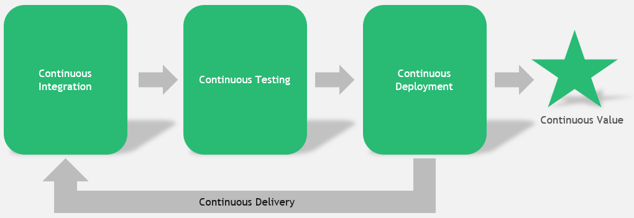
Continuous Testing
Common Types | Description
Unit testing | Testing discrete units of code in isolation from other code (e.g., testing a single method). Leverages mocking to stabilize other system dependencies so that tests are repeatable. Code coverage often used to assess quality & sufficiency of unit testing. Should be automated.
Regression testing | Testing that verifies that newly introduced changes for development of a feature do not inadvertently break other, existing features. Automated unit tests can also fill the role of a regression test suite nicely. Quickly confirming no breakages.
Integration testing | Testing that verifies that groups of components & component features operate correctly when combined with other features (e.g., multiple functions or modules that provide a larger “chunk” of functionality). Usually represents a layer above unit testing but below functional testing. Should be automated.
Functional testing | Testing that verifies functional requirements for critical workflows in the software end-to-end. Can be (and probably should be) implemented as automated black box tests, requiring minimal knowledge & minimal assumptions about the inner workings of the software.
Acceptance testing | Testing that verifies the functionality of the software against specific acceptance criteria defining the difference between “good” & “bad”. May include manual testing/utilization by a subset of testers to verify that the software will operate correctly when leveraged by end users in production. AKA does the software do what it is supposed to from the end user’s perspective?
Security testing | Testing that verifies the functionality of the software against critical security requirements as identified & prioritized via threat modeling. Through a combination of static & dynamic testing, assesses the software for security vulnerabilities or deficiencies from a compliance & regulatory perspective (A.K.A. DevSecOps). Examples include SQL Injection and Cross-Site Scripting.
Performance testing | Testing that verifies that the software will meet defined SLAs (Service Level Agreements) when exercised under load or stress. Can also be used to validate the software’s ability to elastically scale (out or in) based on volumes. How does the software perform under load?

Slide 64
“Shift Left” Testing Approach - Redux
DevOps (and its CI/CD automation tools) are all about creating trust – in the tools and processes, and in the code itself. Key to this is testing.
A popular movement in DevOps is called “shift left” testing. It is an approach to software testing and system testing in which testing is performed earlier in the lifecycle (i.e., moved left on the project timeline)
This means developers are getting involved more in testing.
A common tradeoff to examine here: How long does a full set of tests take? How often are devs checking code into the branch that is tested? Do the tests take so long that code changes are getting backlogged? How to we prioritize tests in this situation?

Slide 65
Distributed Version Control and Git

Slide 66
What is Version Control?
Programs AND work practices that we use to track and control text documents
What documents? Source code - the text files we use to create our executable program
Helps facilitate multiple contributors on a project
Allows us to revert to previous iterations of code base as needed
Notes:
INSTRUCTOR NOTES:
REVIEWER COMMENTS:
PB: Who can give me an example?

Slide 67
The Past: Client/Server Version Control
Prior to 10-15 years ago, most version control used client/server model:
One computer (version control server) had all source code files; it was usually on-site
Client computers (devs) could “check out” a file with the server – that would lock the file to changes
When dev done with work, submits change to server
Once change is made, the file is unlocked for others to modify
Disadvantage: geographically distributed teams weren’t possible; multiple devs can’t work on the same file
Notes:
INSTRUCTOR NOTES:
REVIEWER COMMENTS:

Slide 68
The Present: Distributed Version Control
The source code files are distributed – a full copy of all files, and their entire history, exists on every developers’ computer
Multiple devs can work on the same file simultaneously – when they merge, a computer program will handle routine merge actions; merge conflicts are raised for human interaction
There are a few popular programs:
Subversion
Mercurial
Git
Git is by far the most popular
Notes:
INSTRUCTOR NOTES:
REVIEWER COMMENTS:

Slide 69
Git
What is it?
Open-source distributed version control system
Takes “snapshots” of an application folder as changes occur
Includes both a local and remote component
Changes are local and are synced with remote as needed
Keeps a log of history of changes and allows return to previous version if required
Available at https://git-scm.com/ for download & installation

Slide 70
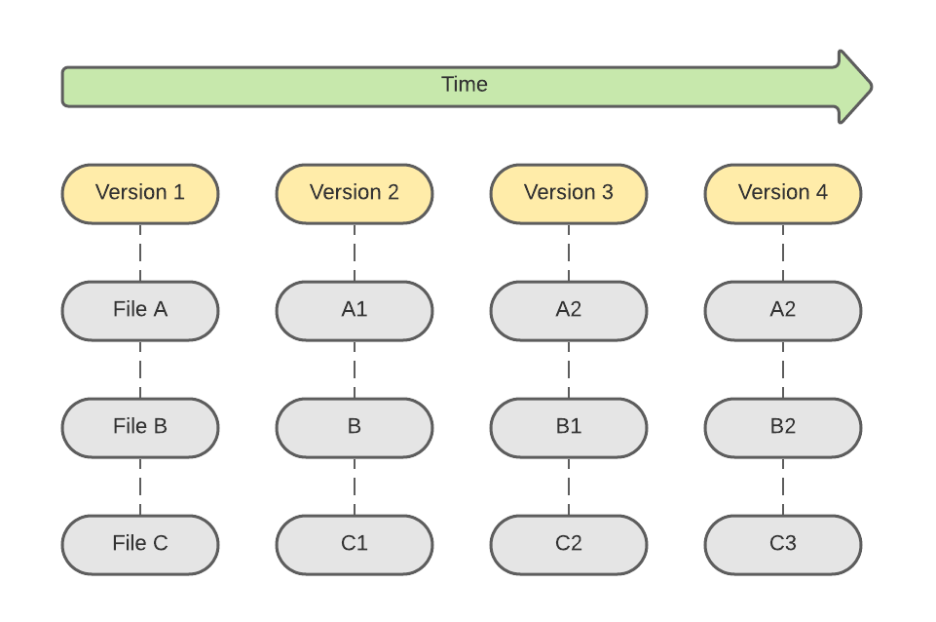
Check-ins Over Time in Git
Other version control systems track a running list of differences in each file over time
Git keeps snapshots of the entire folder at each check-in over time
Uses checksums to verify that contents of snapshot not tampered with

Slide 71
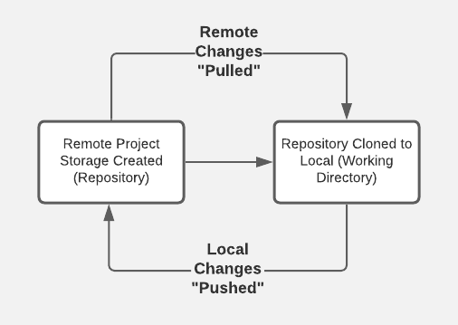
Typical Workflow
Over time, local is refreshed periodically from remote to absorb changes from other devs on the team
3
Remote storage location created (e.g., on github.com)
Branch created locally (or “checked out”) and pushed upstream to remote repo
1
2
4
Over time, changes in local are persisted to remote (checked in); when feature work complete, a PR (Pull Request) is submitted to request merge of branch to mainline
NOTE: Also, able to initiate repo creation from local command-line
Notes:
github.com is a site used to host remote GitHub repositories for access over the Internet; there’s also an Enterprise version that provides storage isolated to an organization

Slide 72
The Three Git States
Staged
File changed
Not yet committed to local database
Includes a short message describing contents of the commit
Persists current snapshot (including staged files) to local database
Modified file marked for inclusion in next commit snapshot
Can be selective about which modifications get staged
Modified
Committed
Notes:
Local database in this case is the .git directory that is available in every Git working directory

Slide 73
Demo
Notes:
Demo will be interweaved with the upcoming slides (toggle between slides & demo)
Demonstrate:
Cloning a repository
Contents (including hidden .git folder)
Talk about .gitignore and purpose – show https://www.toptal.com/developers/gitignore
Creating a new branch
Push branch upstream
Regular pull of updates from remote
`git status`
`git add` (staging)
`git commit` (commit)
Push of local updates to remote
Command-line and VS Code
Demonstrate:
Initiating creation of repo locally from command-line

Slide 74
Configuring Git
git --version to confirm Git is installed and to check version
git config --global user.name “<username>” to set username
git config --global user.email “<email>” to set user email address
File changes will be identified in Git history using this information

Slide 75
Configuring Git
Use git config --list to see all configuration settings
Use git config <setting name> to view a specific setting
For example, git config user.email

Slide 76
Create a Repository
Public or private repository can be created with hosting service (e.g., GitHub)
To link with local snapshot of remote repo, have a couple of options:
Initialize local from command line, add files locally, add/push to remote
Use URL from remote to pull to local via clone

Slide 77
Push to Remote
Create and/or navigate to target folder at local
With an existing repo at hosting provider (e.g., GitHub), execute the following:
echo “# <initial README.md text>” >> README.md
git init
git add README.md
git commit -m “<commit message>”
git remote add origin <HTTPS URL to repository>
git push -u origin main

Slide 78
README.md
echo “# <project title>” >> README.md creates new README file
Usually, a Git repo will include a “markdown” file with info about the repo
Markdown syntax is used to apply formatting characters to raw text

Slide 79
README.md
When displayed in “markdown” reader, formatting is applied
For example, “# “ in the echo statement formats text as a header
One great option for previewing the markdown is using the “Open Preview” feature in Visual Studio Code
Cheat sheet for markdown syntax at https://www.markdownguide.org/cheat-sheet

Slide 80
git init
git init initializes local repo using configuration template
After executing, folder recognized as local Git repository

Slide 81
git add
git add README.md “stages” the README.md file for commit in Git
Reminder – files in Git can be in 1 of 3 stages:
Modified – file changed but not yet staged or committed
Staged – file ready for commit
Committed – file changes persisted to local repo; ready for potential push to remote

Slide 82
git commit
git commit -m “<commit message>” persists staged files to local repo
-m flag used to specify message to attach to current commit snapshot
At this stage, file changes are persisted locally but not yet remotely

Slide 83
git remote add
git remote add origin <HTTPS URL to repository> used to add remote
Configures link between local and remote at hosting provider
If target remote is a private repo, will require additional security
Can use a personal access token (with GitHub)

Slide 84
git push
git push -u origin main used to persist branch and changes to remote
-u used to specify “upstream” (or remote) branch target
origin is reference name for remote repo
main is name of branch to push
Again, if private repo, will require additional security to complete

Slide 85
git clone
For initial pull of repository from remote (e.g., GitHub) to local, use git clone
Create and/or navigate to folder where new repo folder should exist
Format is git clone <HTTPS URL to repository>

Slide 86
git clone
If repo is private, user will need to be granted access
Public repos can be cloned without additional access being granted
Upon completion, new folder will contain local snapshot of remote repo

Slide 87
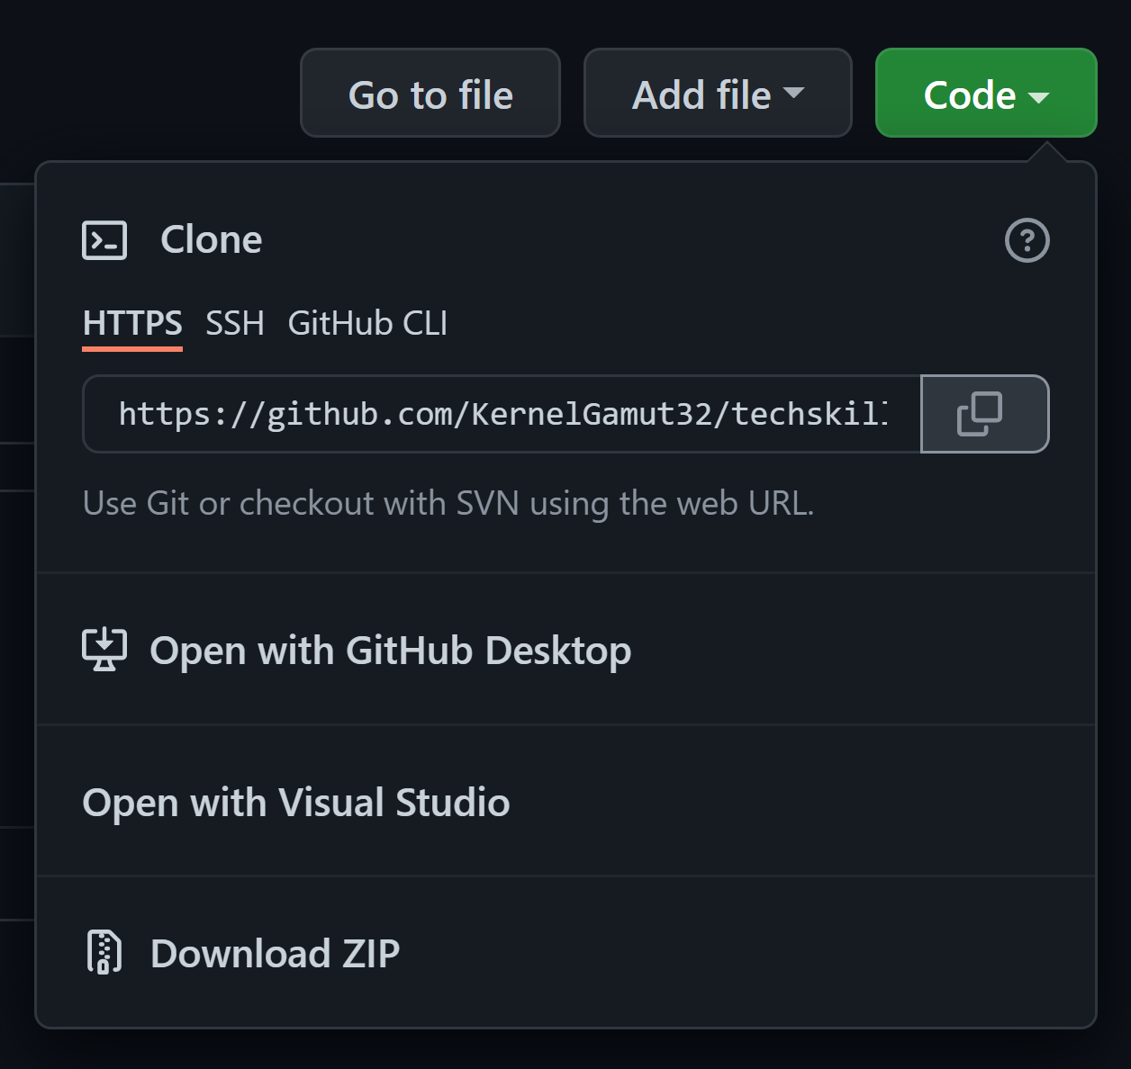
git clone
On repo “home page” in GitHub, clone repository URL can be found/copied using the “Code” dropdown

Slide 88
git pull
Local repository can be refreshed from remote (as required)
Canonical use case is updating local version of shared branch with others’ changes
With branch checked out locally, use git pull origin <branch name> or git pull (which will default to currently checked out branch name)

Slide 89
Lab
Notes:
Creating a new repository in GitHub
Cloning that repository locally
Creating a new repository locally
Pushing that repository to remote
Use https://docs.microsoft.com/en-us/learn/modules/intro-to-git/ + https://docs.microsoft.com/en-us/learn/modules/create-git-project/

Slide 90
Branching in Git
Branches provide segregated snapshots of the codebase for parallel workstreams
Often, branches created from mainline for development of a specific feature
Structured process used to merge branches back into mainline

Slide 91
Branching in Git
Use git checkout –b <branch name> in local working directory to create new branch
Use git push –u origin <branch name> to push branch to remote for tracking
git branch --list used to list existing branches

Slide 92
Branching in Git
git checkout <branch name> used to switch to different local branch
git fetch used to refresh local list with list of newly added remote branches

Slide 93
Making Code Changes
Checkout target branch for development
Make necessary code changes – including adds, updates or deletes
Use git status to see the state of files in the current branch

Slide 94
Making Code Changes
Use git add to stage changes for push to remote
Either git add <filename> or git add –A (for all updates in directory)
Use git status to check status of modified vs. staged artifacts

Slide 95
Making Code Changes
To unstage 1 or more files, use git restore --staged <file or wildcard pattern>
git restore --staged . used to unstage current directory
Use git add to restage

Slide 96
Pushing to Remote
Committed files are pushed to remote using git push
Format is git push origin <branch name> or git push (to push to currently checked out branch in remote)
User will need permissions on repo to push
May be prompted for credentials with hosting provider to complete

Slide 97
Pushing to Remote
To prep staged files for push to remote, use git commit
Format is git commit -m <commit message>
git status will reflect status change

Slide 98
Pull Requests
When feature complete and ready for merge, engineer submits pull request (PR)
Allows peer review of proposed changes
Usually governed by policies around number of required reviewers, successful build in branch before merge, etc.

Slide 99
Lab
Notes:
Creating a new branch on a cloned repository
Making changes to that branch
Pushing those changes to remote
Creating a pull request from those changes
Use https://docs.microsoft.com/en-us/learn/modules/collaborate-with-git/

Slide 100
Merging in Git
Best practice is to favor multiple smaller PRs over a few larger ones
Helps reduce review risk and chances for conflicts
Also, helps to minimize “drift” between in-progress work and mainline
Notes:
Larger PR’s can last longer – over time, mainline is changing from other dev work. Keeping the 2 in sync and moving in smaller steps.

Slide 101
Merging in Git
The larger the PR, the longer it can stay open
Other features are being merged into mainline while development continues
If Git is unable to automatically merge and resolve multiple changes to the same file, results in a conflict

Slide 102
Merging in Git
Good practice to regularly refresh branch with pull from mainline
Helps to keep branch in sync with mainline
Allows developer to find and fix merge conflicts in the branch before submitting PR
Notes:
* Conflicts requiring manual intervention can be addressed before PR submission
* When PR is approved and merged, branch can be deleted

Slide 103
Managing Merge
With target branch checked out, use git merge to pull in updates
For example:
git checkout branch-name
git merge origin main

Slide 104
Managing Merge
Any merge conflicts will be called out on the command-line
Use git status and git diff to list merge conflict details
Manually update files to resolve and push changes to remote

Slide 105
Managing Merge
Once all conflicts have been resolved, run git merge once more
Do a final push to remote for the branch to refresh
To “cancel” merge, use git merge --abort

Slide 106
Managing Merge
Alternatively, many IDEs will help you automatically manage via UI

Slide 107
Demo
Notes:
Executing a merge
Encountering and managing a merge conflict
Show in Visual Studio Code (or similar)

Slide 108
Lab
Notes:
Executing a merge
Encountering and managing a merge conflict
Use https://docs.microsoft.com/en-us/learn/modules/branch-merge-git/

Slide 109
Branching in Git

Slide 110

Branching Strategy
A consistent strategy for branching is important
Define a standard set of strategy components that enable:
- Simplicity
- Stability
- Efficient and repeatable releases

Slide 111
Feature Branches
Feature branches are branches created from the main branch
Use for new features as well as bugs
Helps with tracking evolution of software over time
Keeps developers’ parallel work separate
Use a consistent naming strategy for the branch (e.g., user-name/feature-name)

Slide 112
Use Pull Requests
Feature branch changes should be reviewed and merged via PR
Repo can be configured with a minimum number of reviewers to enable merge
Can also integrate build steps into the PR process so successful build is confirmed before merge
Keep PRs small

Slide 113
Protect Mainline
Mainline should be clean and kept up-to-date
Provides a stable, common starting point for developers creating feature branches from it
Use branch policies to protect mainline
Avoid direct merge there – use PRs instead

Slide 114
Developing in a Branch
The longer a feature branch exists (and the larger the amount of code changes it contains), the higher the likelihood of a merge conflict
To help minimize conflicts, a developer should keep their feature branch up-to-date with latest
Can be done by regularly merging mainline into the branch during development

Slide 115
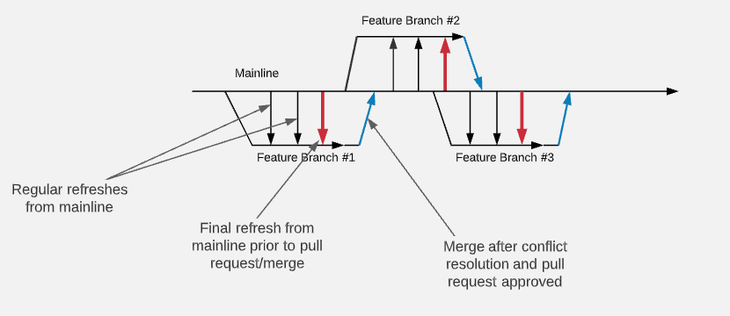
Developing in a Branch
Notes:
AKA trunk-based development

Slide 116
Managing Releases
Optionally, release branches can be used for managing releases of the software
Provides a point-in-time version snapshot
If bugs are found in a release, fixes need to be made in both release branch and mainline
Couple of options: fix in mainline and port to release branch or fix in release branch and backport to mainline

Slide 117
Knowledge Check
Which of the following best describes why we use feature branches?
A. It’s the branch where all major release will be built from
B. It helps developers keep feature updates/bug fixes separate from the main branch
Enter the letter corresponding to your answer in chat

Slide 118
Knowledge Check
Why do we use pull requests?
To ensure code is reviewed before merging to the main release branch
To ensure that unit testing is done before merging to the main
Enter the letter corresponding to your answer in chat

Slide 119
Knowledge Check
How do we mitigate merge conflicts with our long living feature branches?
By running continuous tests on our feature branch code
By regularly merging the main branch into the feature branch during development
Enter the letter corresponding to your answer in chat

Slide 120
Filler
If time still left, consider doing the following to wrap up:
Option 1: Have the associates discuss in groups: (PREFERRED OPTION)
Key learnings coming out of the week
Identify 3 – 5 ways that you could potentially apply the material you’ve been learning about this week in your teams and/or in your day-to-day
Option 2: Do a couple of quick demos on GitHub Actions as one form of automated CI/CD – won’t match exactly with what they are doing toolwise but concepts will be applicable
https://docs.microsoft.com/en-us/learn/modules/github-actions-automate-tasks/
https://docs.microsoft.com/en-us/learn/modules/github-actions-ci/

Slide 121




Thank you!
If you have additional questions, please reach out to me at:
erik-gross@pluralsight.com

